Slide 1
Children’s Centre Services
What happens at a Children’s Centre

Slide 2

What Happens at a Children’s Centre
The centres are places where you can go and meet up with mums, dads and carers to access: information, advice and support during tough times; sessions and training courses on child development and parenting; volunteering opportunities and much more.
All centres offer breastfeeding advice and support for new mums and offer the same core activities and courses with lots of inside and outside play sessions for the little ones.
To give Parents more choices and flexibility, we have brought in some changes to our service offer and removed the ward restrictions. Therefore, from 1stJune 2023, if you are a resident of the London Borough of Redbridge, you can attend sessions and services from any of the Children’s Centres in the borough.

Slide 3

Bookings and registrations
Families can now register with the Children’s Centre via a QR code, so no longer have to complete a lengthy form. They can book onto sessions via Eventbrite and courses via email, phone or dropping in.
This will make the whole process a lot simpler.

Slide 4

Children’s Centre Service Offer information for Parents/carers

Slide 5
MONDAY | TUESDAY | WEDNESDAY | THURSDAY | FRIDAY
Sensory Room For: Birth to crawling Time: 45-minute slots available 9:00 am – 4:00 pm Booking: Eventbrite or drop-in to book | Sensory Room For: Birth to crawling Time: 45-minute slots available 9:00 am – 4:00 pm Booking: Eventbrite or drop-in to book | Baby Bank (0 to 2 years) For: For Redbridge residents only Time: 9:00 am – 12:00 pm Booking: Drop-in | Sensory Room For: Birth to crawling Time: 45-minute slots available 9:00 am – 4:00 pm Booking: Eventbrite or drop-in to book | Busy Babies For: Birth to crawling Time: 9:30 am – 10:30 am Booking: Eventbrite or drop-in to book
Parent Led Stay and Play For: Birth to 4 years old Time: 9:45 am – 11:00 am Booking: Eventbrite or drop-in to book | Chatter Matters (3-week course) For: 2.5 to 4 years old Time: 9:30 am – 10:30 am Booking: Email, phone or drop-in to register your interest | Early Movers For: Birth to crawling Time: 9:30 am – 10:30 am Booking: Eventbrite or drop-in to book | Book Club For: Birth to 4 years old Time: 9:30 am – 10:30 am Booking: Eventbrite or drop-in to book | Coffee and Chat For: Parents and carers Time: 10:30 am – 11:30 am Booking: Eventbrite or drop-in to book
Bookstart (4-week course) For: 18 months to 4 years old Time: 9:30 am – 10:30 am Booking: Email, phone or drop-in to register your interest | Rhyme Time for Toddlers For: Walking to 4 years old Time: 9:30 am – 10:30 am Booking: Eventbrite or drop-in to book | Baby Musicians (6-week course) For: Birth to crawling Time: 11:30 am – 12:30 pm Booking: Email, phone or drop-in to register your interest | Positive Minds for Babies (4-week course) For: Birth to crawling Time: 9:30 am – 10:30 am Booking: Email, phone or drop-in to register your interest | Story and Rhyme For: Birth to 4 years old Time: 9:30 am – 10:30 am Booking: Eventbrite or drop-in to book
Busy Toddlers For: Walking to 4 years old Time: 11:30 am – 12:30 pm Booking: Eventbrite or drop-in to book | Baby Massage (4-week course) For: 6 weeks to 6 months Time: 11:30 am – 12:30 pm Booking: Email, phone or drop-in to register your interest |  | Positive Minds for Children (4-week course) For: Walking to 4 years old Time: 9:30 am – 10:30 am Booking: Email, phone or drop-in to register your interest | Sensory Adventures for Babies For: Birth to crawling Time: 11:30 am – 12:30 pm Booking: Eventbrite or drop-in to book
Baby Bounce and Rhyme For: Birth to crawling Time: 11:30 am – 12:30 pm Booking: Eventbrite or drop-in to book | Let’s Talk Baby Talk For: Birth to crawling Time: 11:30 am – 12:30 pm Booking: Eventbrite or drop-in to book |  | Stay and Play for Children with SEND For: Birth to 8 years old Time: 11:30 am – 12:30 pm Booking: Eventbrite or drop-in to book
 |  |  | Sensory Adventures for Babies For: Birth to crawling Time: 11:30 am – 12:30 pm Booking: Eventbrite or drop-in to book
CENTRE CLOSED 1:00 pm – 2:00 pm | CENTRE CLOSED 1:00 pm – 2:00 pm | CENTRE CLOSED 1:00 pm – 2:00 pm | CENTRE CLOSED 1:00 pm – 2:00 pm | CENTRE CLOSED 1:00 pm – 2:00 pm
Busy Babies For: Birth to crawling Time: 2:00 pm – 3:00 pm Booking: Eventbrite or drop-in to book | Busy Toddlers For: Walking to 4 years old Time: 2:00 pm – 3:00 pm Booking: Eventbrite or drop-in to book | Sensory Room For: Birth to crawling Time: 45-minute slots available 2:00 pm – 4:00 pm Booking: Eventbrite or drop-in to book | Active Play For: Walking to 4 years old Time: 2:00 pm – 3:00 pm Booking: Eventbrite or drop-in to book | Sensory Room For: Birth to crawling Time: 2:00 pm – 4:00 pm, 45-min slots Booking: Eventbrite or drop-in to book
Coffee and Chat For: Parents and carers Time: 3:00 pm – 4:00 pm Booking: Eventbrite or drop-in to book | Story and Rhyme For: Birth to 4 years old Time: 2:00 pm – 3:00 pm Booking: Eventbrite or drop-in to book | Toddler Musicians (6-week course) For: Walking to 4 years old Time: 2:00 pm – 3:00 pm Booking: Email, phone or drop-in to register your interest | Cook Well Eat Well (4-week course) For: Adults Time: To be confirmed Booking: Email, phone or drop-in to register your interest | Let’s Get Ready for Nursery or Reception For: 2 to 4 years old Time: 2:00 pm – 3:30 pm Workshop 1 on 8 September – Oral Health, Ditch the Dummy & Bottle. Booking: Eventbrite or drop-in to book Workshop 2 on 15 September – Toilet Training. Booking: Eventbrite or drop-in to book Workshop 3 on 22 September – Communication & Language. Booking: Eventbrite or drop-in to book Workshop 4 on 29 September – Positive Behaviour. Booking: Eventbrite or drop-in to book Workshop 5 on 6 October – Safety Awareness Within the Home. Booking: Eventbrite or drop-in to book Workshop 6 on 13 October – Physical Wellbeing. Booking: Eventbrite or drop-in to book
Baby Massage (4-week course) For: 6 weeks to 6 months Time: 2:00 pm – 3:00 pm Booking: Email, phone or drop-in to register your interest | Information and Advice For: Parents and carers Time: 3:45 pm – 4:15 pm Booking: Drop-in | Positive Minds for Parents and Carers For: Parents and carers Time: 2:00 pm – 3:00 pm Booking: Eventbrite or drop-in to book | Coffee and Chat For: Parents and carers Time: 2:00 pm – 3:00 pm Booking: Eventbrite or drop-in to book | Self–weigh with Advice and Guidance For: 6 weeks to 4 years old Time: 2:00 pm – 3:30 pm, Slots available Booking: Eventbrite or drop-in to book
Information and Advice For: Parents and carers Time: 3:45 pm – 4:15 pm Booking: Drop-in |  |  | Information and Advice For: Parents and carers Time: 3:45 pm – 4:15 pm Booking: Drop-in | Information and Advice For: Parents and carers Time: 3:45 pm – 4:15 pm Booking: Drop-in
Redbridge FiND | Children's Centres in Redbridge
At the back of the brochure the parent will find the link to the timetables for all the Children’s Centres and the booking details.
The parent will also find the Eventbrite link to book them onto these sessions.
Redbridge FiND | Children's Centres in Redbridge
Events (eventbrite.co.uk)

Slide 7
Brief Intervention
Children’s Centre will no longer deliver 1:1 FSW support. This can still be accessed through Families Together Hub (FTH).
Instead, there will be group intervention, as such the number of sessions will be increased to accommodate.
Referrals will still be accepted, and families will be contacted and invited to appropriate sessions and courses, i.e., Parent Gym, Chatter Matters, Ready To Learn along with universal sessions such as Baby and Toddler Explorers.

Slide 8
Needs vs Activities
Engagement/ Brief Intervention Criteria for which referrals will be accepted | Examples of activities
Advice, guidance and support with accessing emergency/financial support including 2FEEE. We also give info about relevant council departments and third-sector services such as Welfare Benefits Advice, and Speech and Language Therapy | Baby & Toddler Banks Cost of Living sessions for 1-1 support Provide information about and sign-post to council’s Cost of Living Support services, HSF, FiND, childcare information, services from partner agencies and third-sector services such as Foodbanks Support families with applying for 2YFEE, Health Start scheme etc
Bonding and attachment | Baby Massage Infant Feeding Café Five to Thrive Ready to Learn
Adult mental well-being: Low mood, anxiety, depression, risk of isolation | Coffee & Chat Time for Me New Beginnings ELSA Other activities as appropriate
Child Development: Physical, PSED | Baby/Toddler Explorers Stay & Play Sensory Room Five to Thrive ELSA
Child Development: speech & language developments | Baby/Toddler Music, Bookstart, Chatter Matters, Story & Rhyme and Oral Health.

Slide 9
Needs vs Activities
Needs | Activities/sessions/courses
Parenting/Behaviour/Routine | Parent Gym (Parenting Course) Workshops on Positive Behaviours, boundaries, routine etc.
Getting Ready for School/ Transition | Five to Thrive Ready to Learn workshops – potty training, oral health, healthy eating etc. And all our activities are focused on getting children ready to learn/ready for school and beyond
Referrals from Social Care as part of the family’s care plan/MASH One-Front-Door for engagement with CC | Engage with appropriate CC activities
No Recourse to Public Fund (NRTPF) and Refugees | Engage with appropriate activities and support such as Baby & Toddler Banks, Healthy Start Scheme (if meet qualifying criteria) etc. Sign-post to other appropriate services such as Foodbanks Promoting Children’s Centres services with Hostels
Access to volunteering, training and employment opportunities​ | English Conversation Club Sign-post to ESOL and other adult learning courses from partner agencies Sign-post to other services such as from Work Redbridge, Redbridge Institute, JC+, Redbridge New City College etc Children’s Centres Volunteering Prog

Slide 10
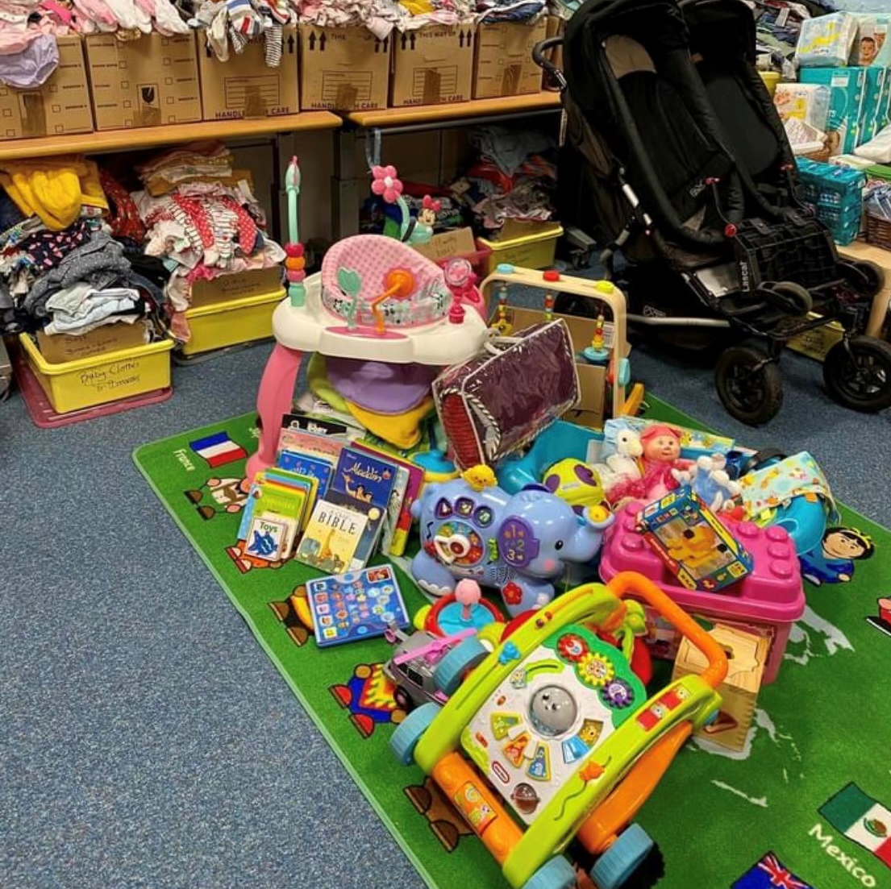
Baby and Toddler Bank
There are now 3 Baby and Toddler Banks in Redbridge:
Orchard – Wednesday 9.00 – 12.00pm
Newbury Hall – Monday 9.30 – 11.30am
Loxford – Tuesday 9.00 – 12.00 & Friday 9.00 – 3.00pm
They are all drop-in services and only open to Redbridge residents.
Donations are very welcome, please contact the individual CC for details.

Slide 11

Any questions

Slide 12
Thank you for your time.

